Slide 1
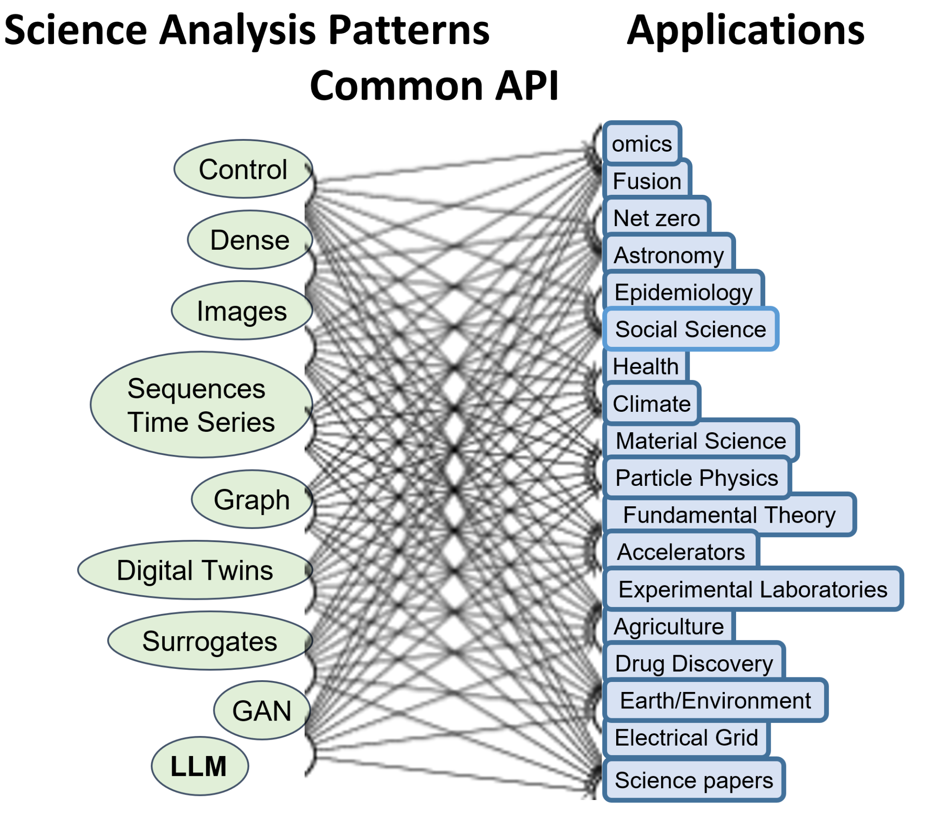

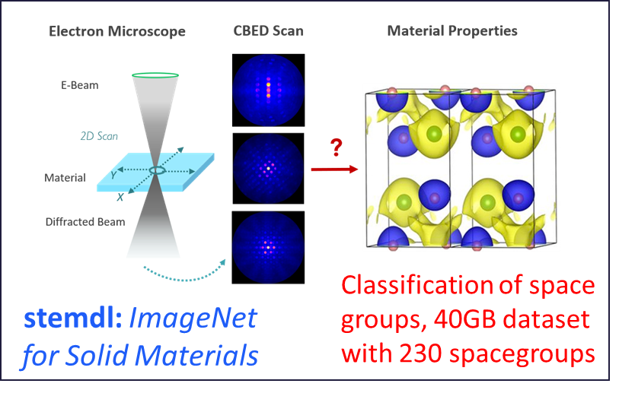
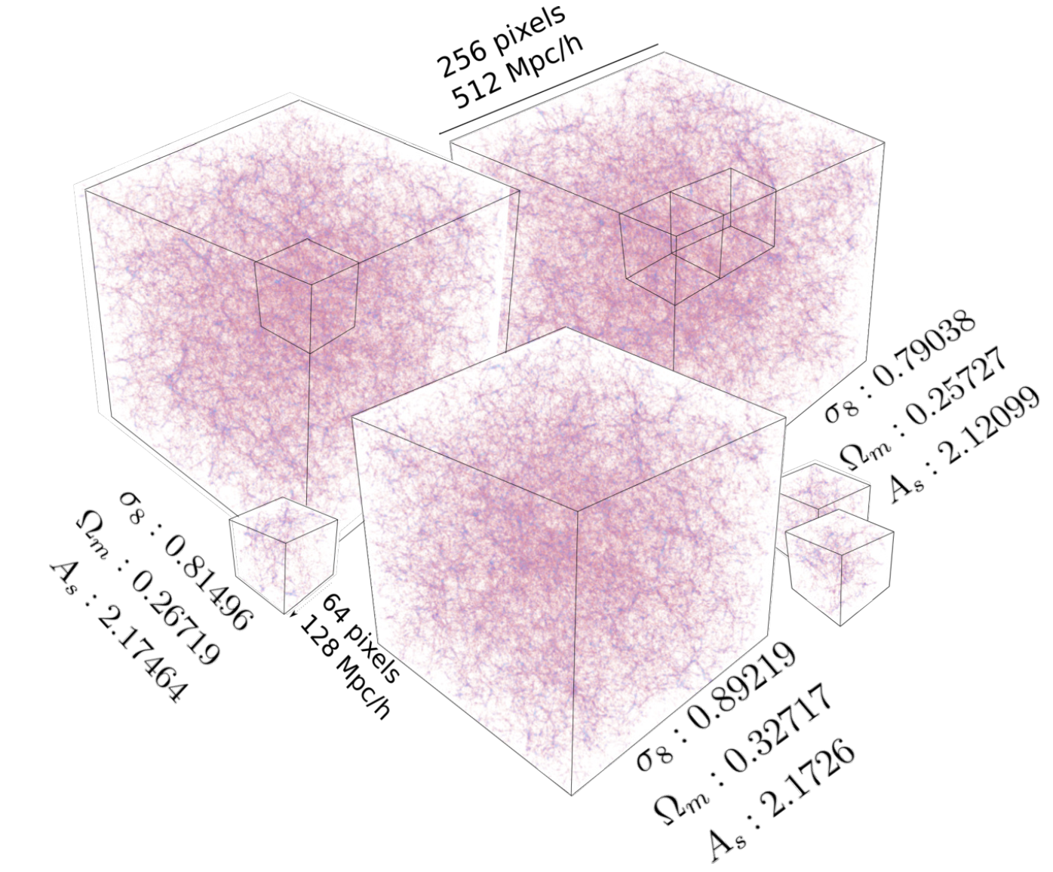
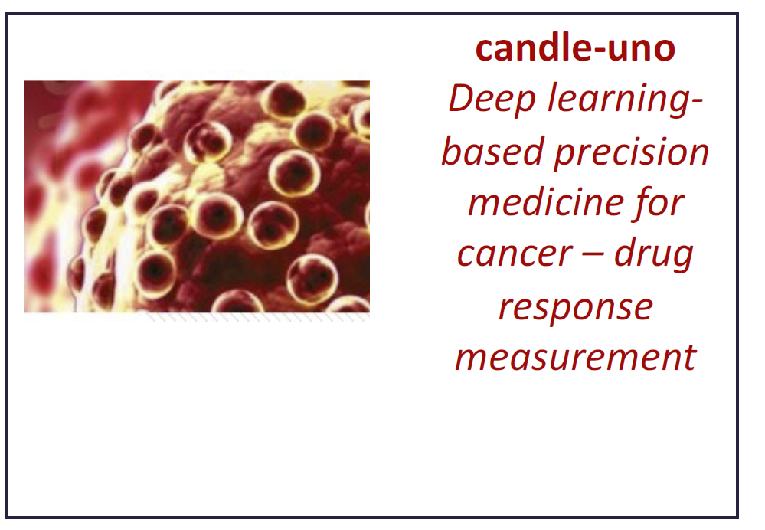
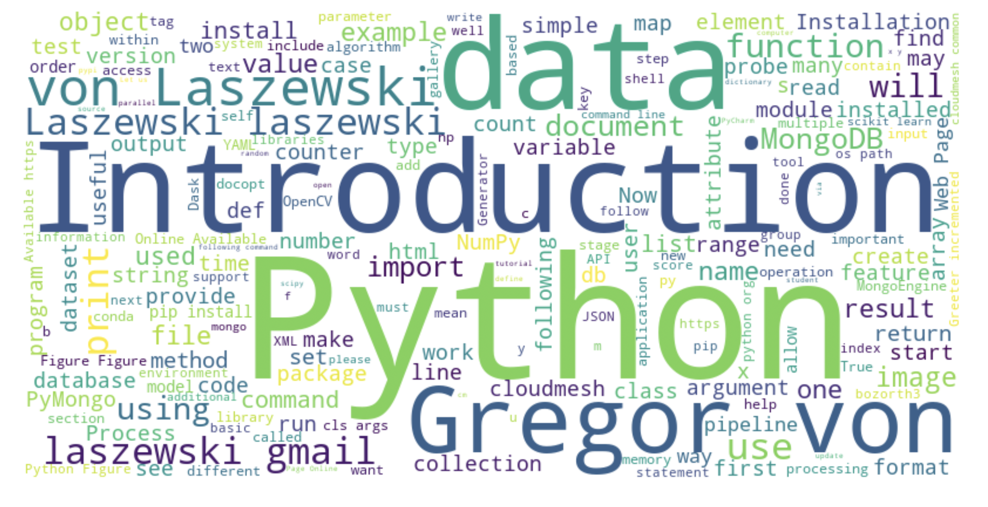
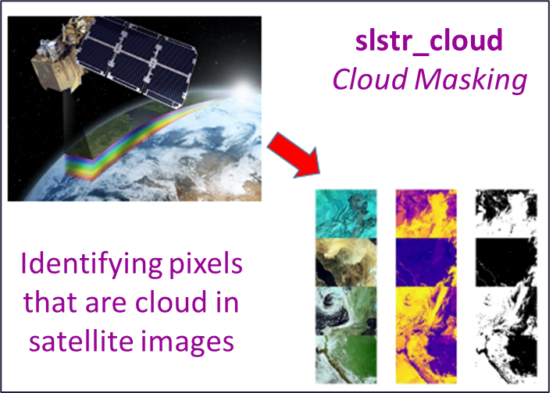
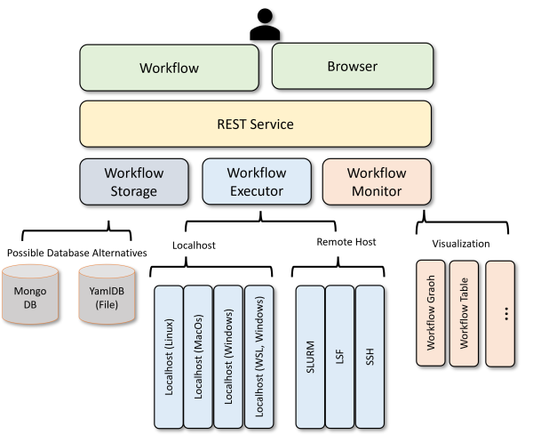
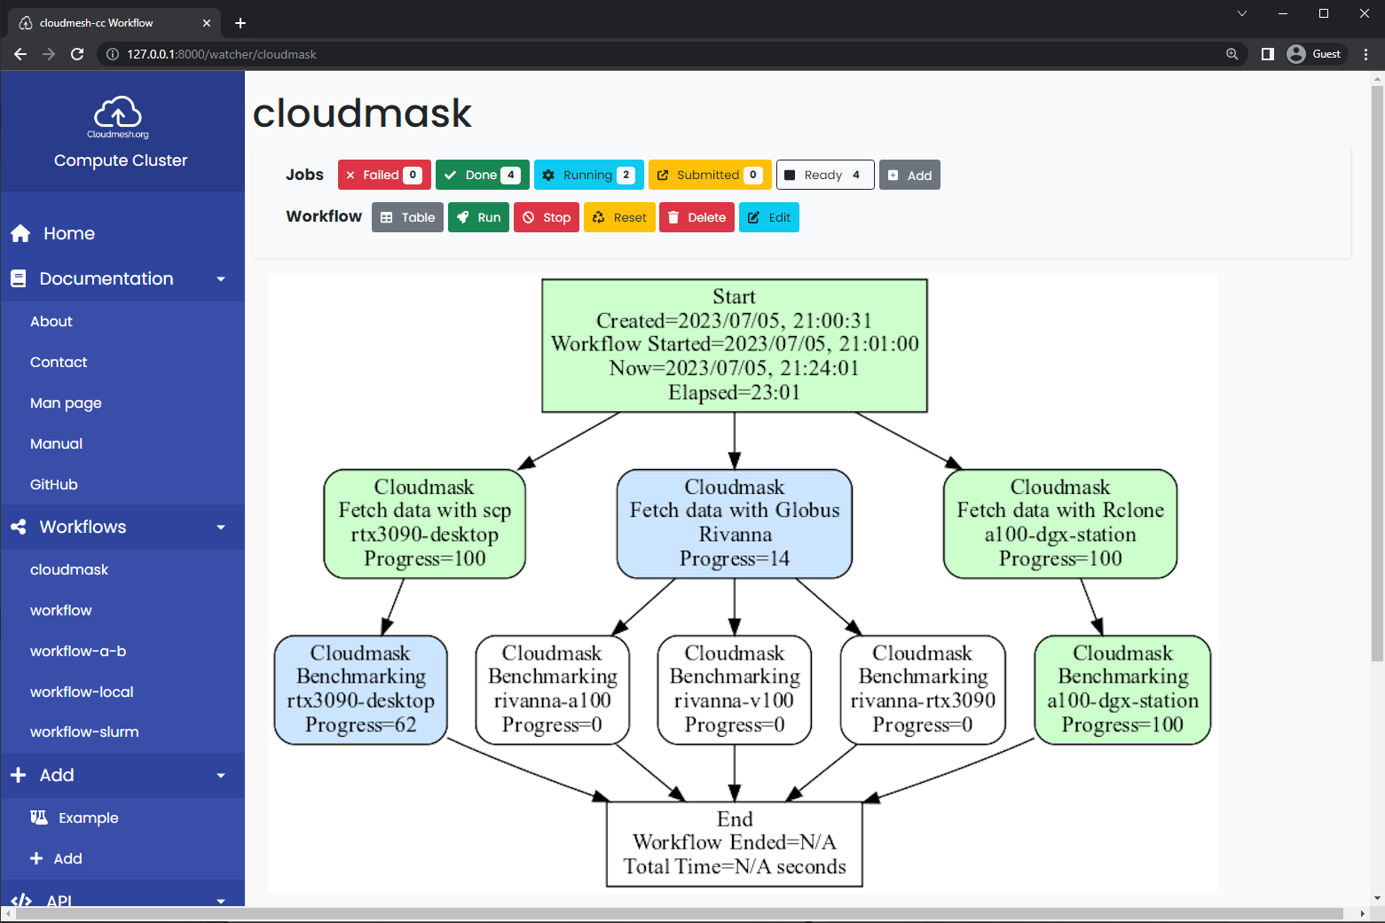
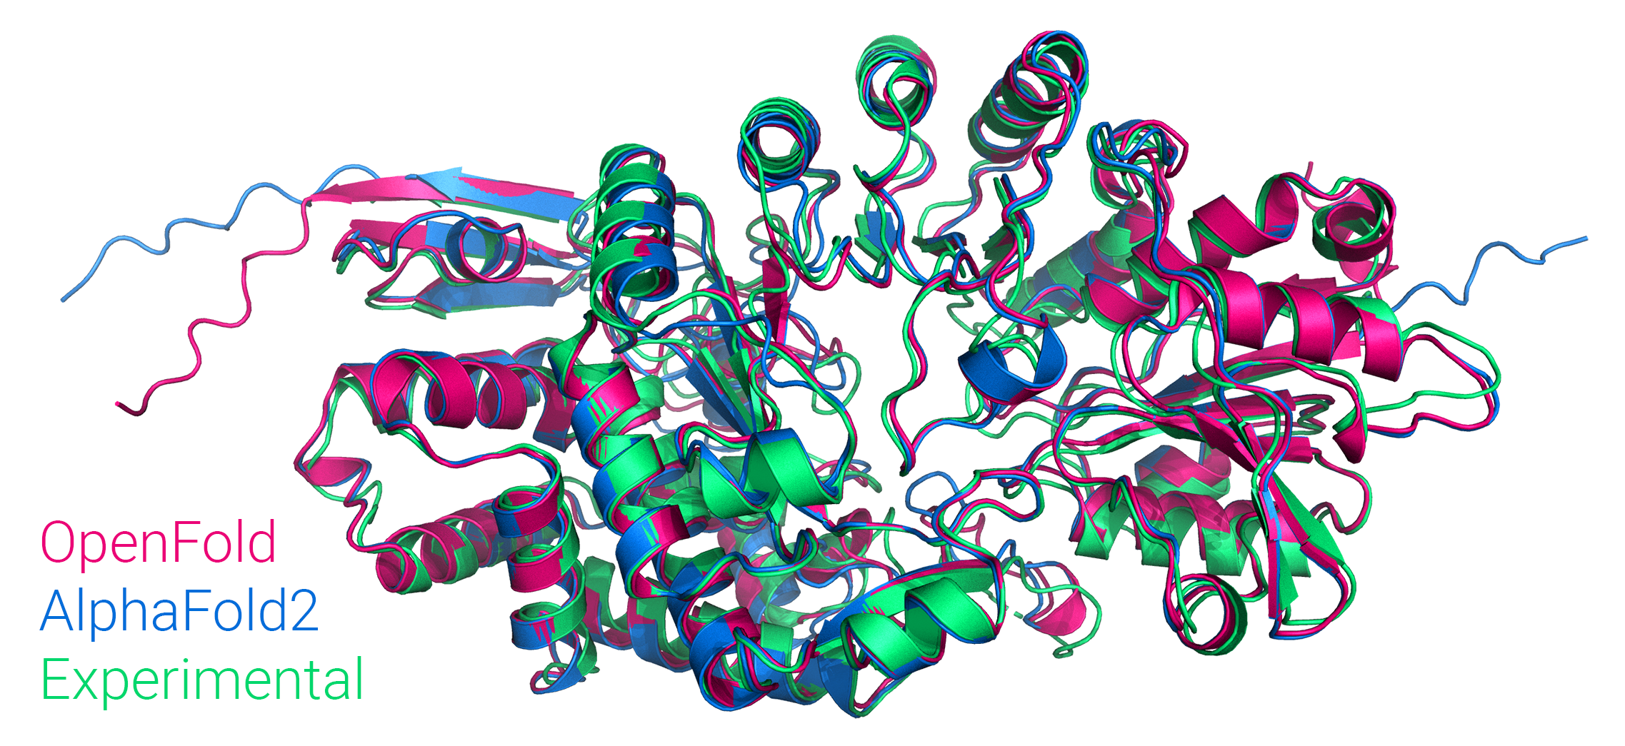
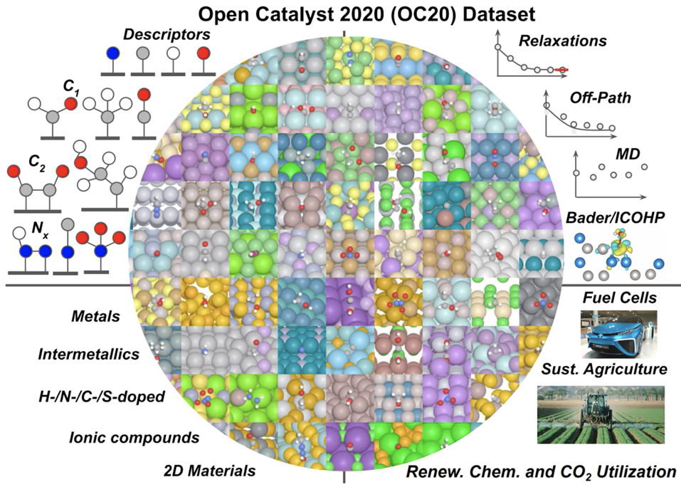
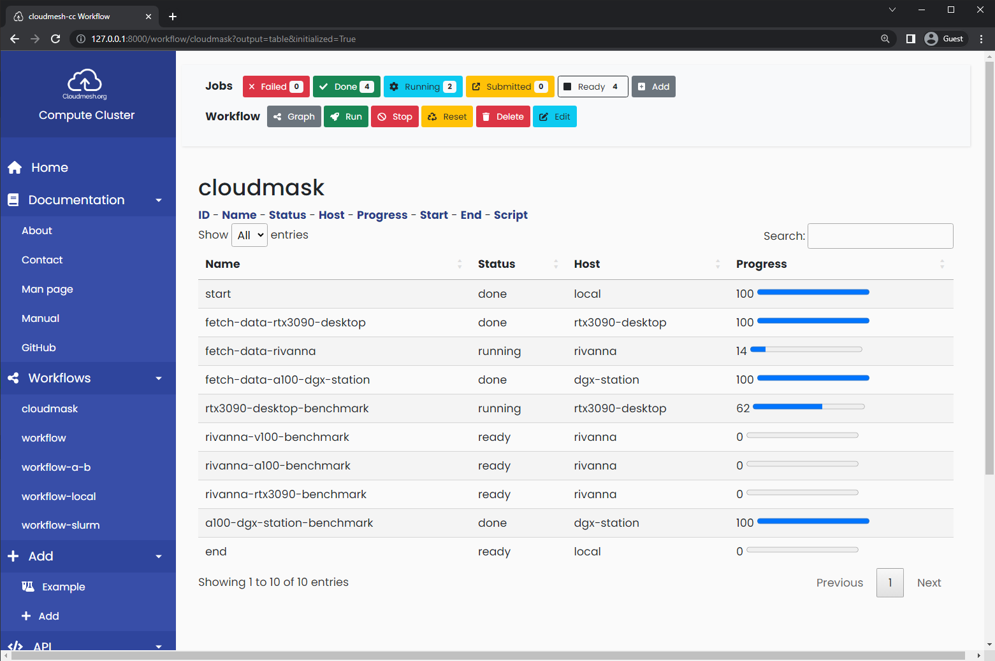
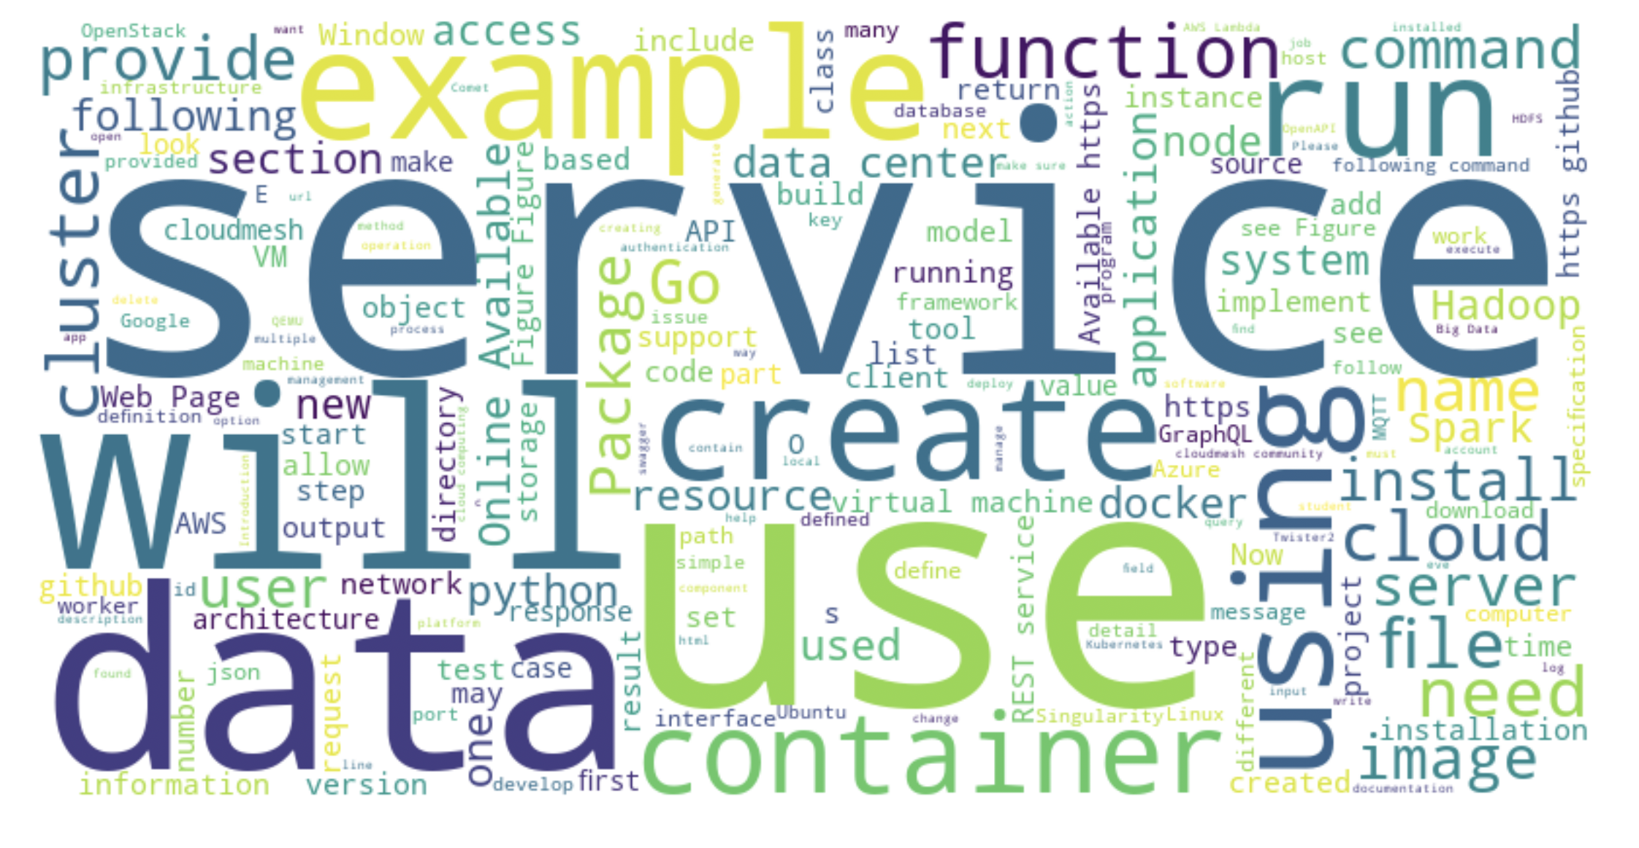
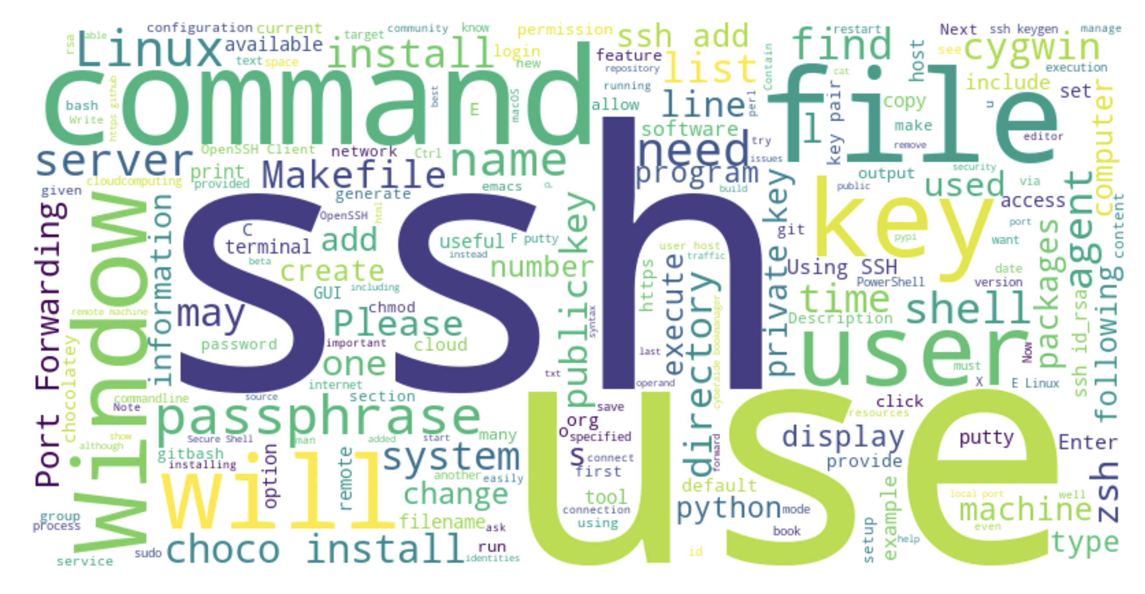
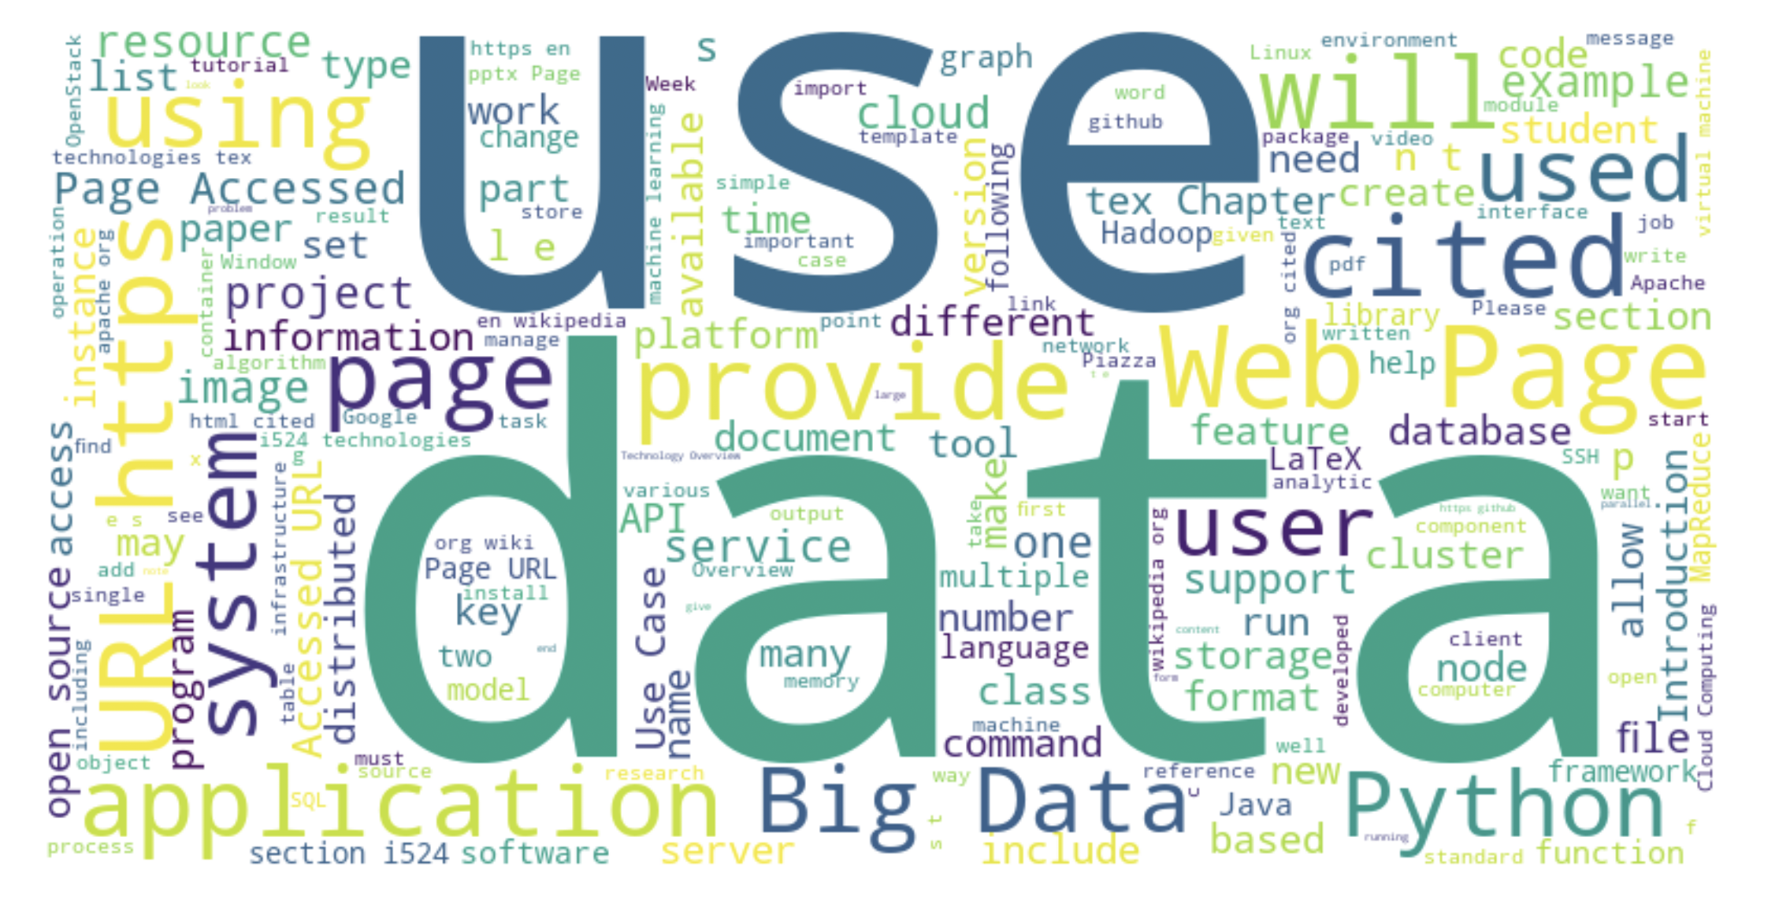
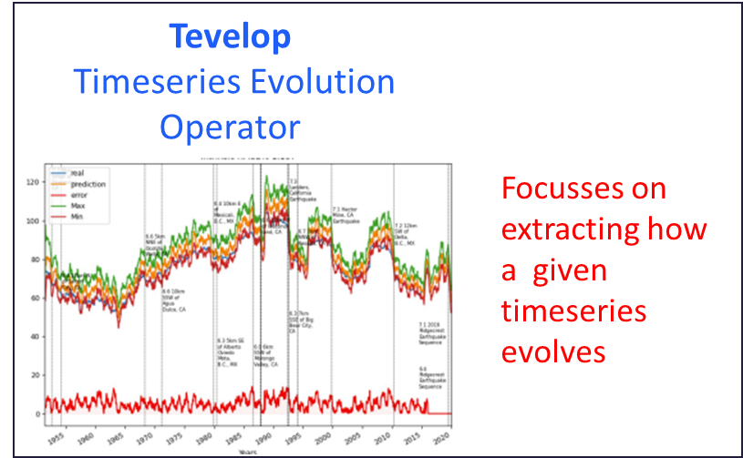
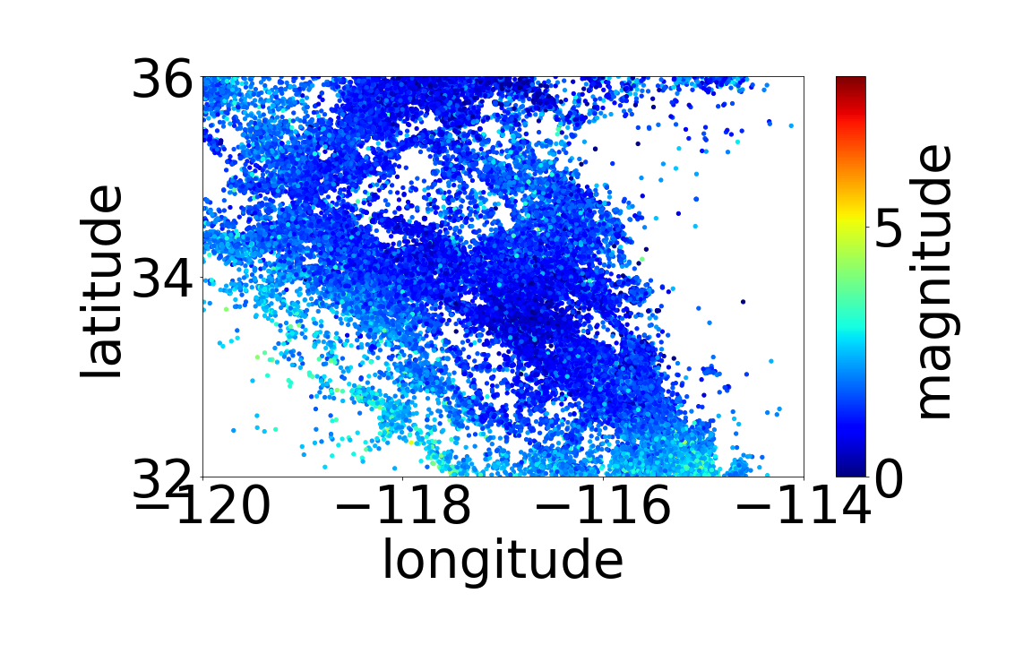



CyberTraining and Technologies for Students from Generation Z
AI for Science and Engineering
Highlights
> 200 undergraduate applied FA 22-SU 23; > 50 applied FA 2023
> 2000 pages educational material; > 170 repositories
Interaction of MLCommons applications
Significant technology development: Hybrid cloud computing interface; Benchmarking ; GPU use; Experiment management; Online and PDF material publication framework; Individually customizable training material selection and production
Training need in
Cyberinfrastructure, Science applications, Artificial intelligence.
Outcome: a well-educated workforce
Rapid changes in these fields require quick adaptation of material
Different backgrounds of students require customization of material
We developed open-source framework and tools that allow customized material to be given to each student after evaluation.
Cyberinfrastructure Training 90% CI 10% AI4Sci
CyberTraining for AI for Engineering and Science 50% CI 50% AI4Sci
AI for Science Training 10% CI 90% AI4Sci
DeepCAM Climate
Multi-modal Science Foundation Models
Selected topics include 2000 Pages of material organized by focus topics:
stemdl
Cosmoflow Universe
Candle-Uno Drug Discovery
MLCommons AI4Science
And HPC Benchmarks
MLCommons Cloudmasking Using Cloudmesh Experiment Execution
Cloudmesh
Compute
Coordinator
GNN Chemistry
Architecture
Openfold Protein Structure
MLCommons Earthquake using Tevelop
Impact of Hyperparameter
controlling inputs and outputs
Earthquake data
GPU Performance
Energy traces
Geoffrey C. Fox, Gregor von Laszewski
NSF 2200409 (Virginia)
NSF 1829704 (Indiana)
vxj6mb@virginia.edu, gregor@virginia.edu
BIOCOMPLEXITY INSTITUTE

